Slide 1
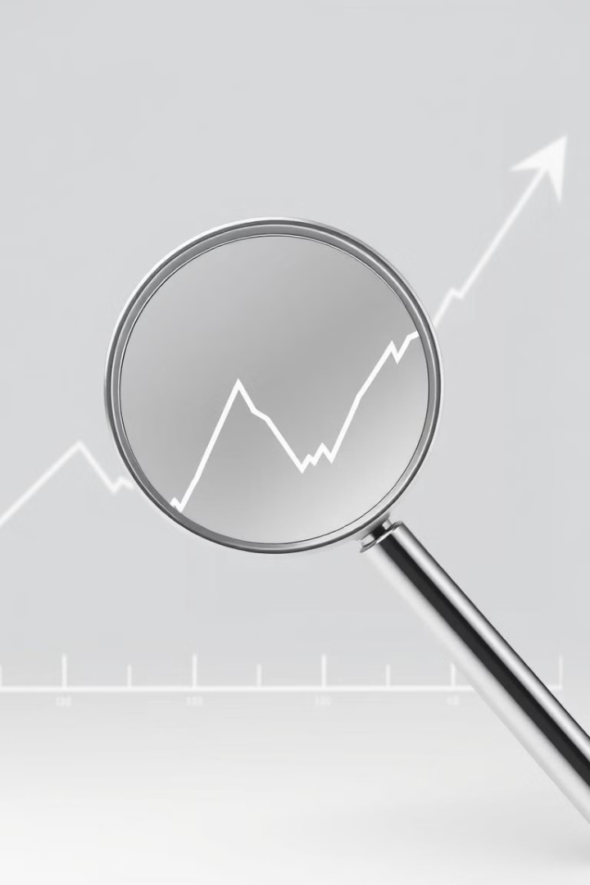

AI-Powered Layoff Prediction & Unemployment Analysis
This presentation explores the development of an AI-powered system designed to predict layoffs and analyze unemployment trends, providing insights to stakeholders across various sectors.
by Anush Dighore

Slide 2
The Layoff Predicament
Unpredictable
Limited Insights
Layoffs are often sudden and leave employees unprepared.
Existing models rely on outdated data, providing insufficient real-time warnings.

Slide 3
Predicting Layoffs & Providing Insights
1
Track Real-Time Trends
2
Predict Layoffs
3
Analyze Sentiment
Analyze job postings, hiring patterns, and company reports.
Use ML models to detect economic downturn signals.
Identify public and employee concerns from news and social media.
4
Provide Insights
5
Suggest Alternatives
Dashboard with layoff risk assessments and job market trends.
AI-powered job recommendations for affected workers.

Slide 4

Building on Past Research
Past Research
Key Papers
Overview of existing models and limitations of current unemployment prediction systems.
Research papers like "Using AI for Labor Market Predictions" and "Sentiment Analysis in Economic Forecasting" highlight the potential of AI in this domain.

Slide 5



Leveraging AI in HR Analytics
Machine Learning
Natural Language Processing
ML models analyze employment trends to predict future workforce needs and potential layoff risks.
NLP processes job market news and reports, extracting key insights and identifying sentiment.

Slide 6





Applications Across Sectors
Employees
Early warning system to prepare for potential layoffs.
Companies
Workforce planning and risk mitigation strategies.
Government & Policymakers
Data-driven employment policies to address unemployment trends.
Job Portals
AI-powered job recommendations based on layoff risks.

